Slide 1
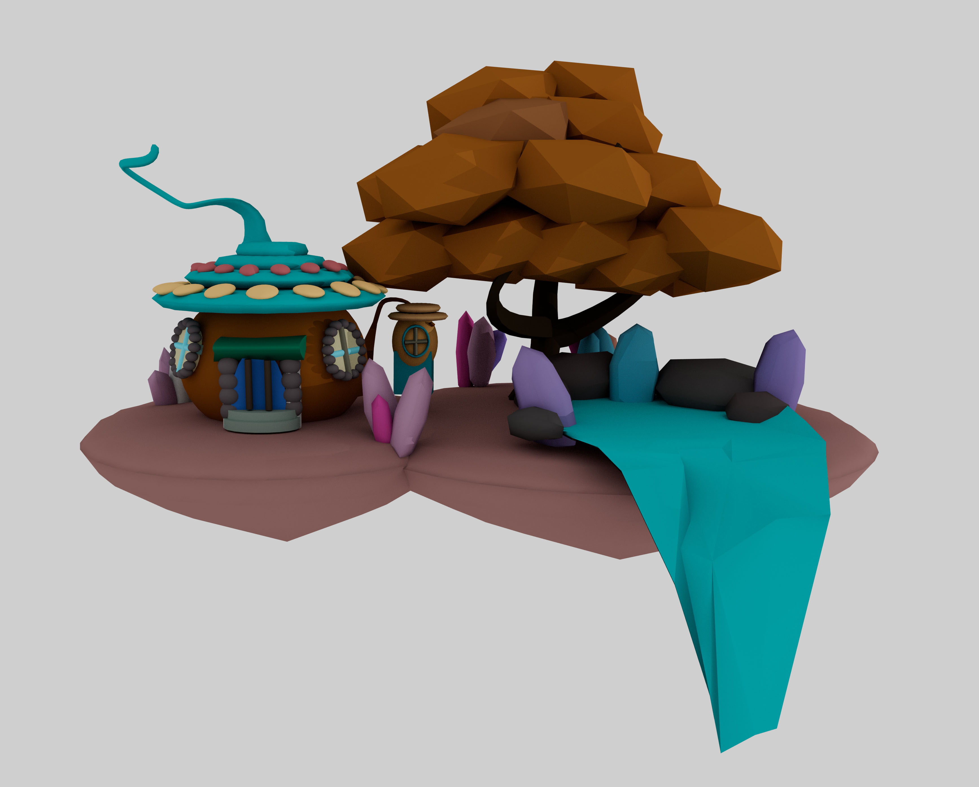
Rotation: 3D story world
Final render image
Analysis
The 3D animation world I built is a crystal forest in the magic world,
where crystals grow everywhere and the inhabitants build their houses
out of giant pumpkins. Before I came to Maya, I always felt that this
software is very mysterious. It is used to create lifelike 3D animation. I
couldn't help but admire its powerful function.
In the beginning, I couldn't even move the cube. But after Monday's
Workshop on Maya, I can use Maya to move, zoom in, zoom out and try to
build simple objects. In the following days, I learned how to build pipes,
branches, paint and render pictures through videos provided by my Tutor
on Moodle and videos on Youtube.
I don't think modeling is a very skilful process, it just requires patient
observation and a simple process of repetition. But in the process of
coloring, I had a lot of trouble, because I didn't know what color to use to
express a magical world. I tried a lot of color sets, pink, purple, but since
the major subject is a pumpkin house, the theme color is orange, then I
used orange as a main color.

